Slide 1
The Landscape of PBMs and Pharmacy
Buddy Pusateri
Dallas/Fort Worth Chapter
September 14, 2023
Notes:
Good morning!
Welcome and thank you for joining our webinar today.
We’ll get started in a few minutes.
Fall activities/faves?

Slide 2

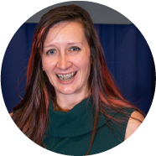
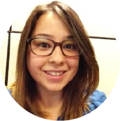

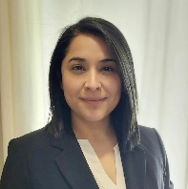
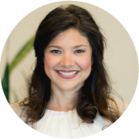
Welcome from our
2023 OFFICERS AND BOARD
PRESIDENT
Rachel Swinnen
CEBS – UMR
VICE PRESIDENT
Barbara Koehrer
CEBS – HEB
TREASURER
Jackie Couture
CEBS – SMU
TECHNOLOGY & ADMINISTRATION CHAIR
Ana Torrescano
CEBS – Marsh & McLennan Agency LLC
SECRETARY
Tangula Morrison
CEBS
PAST PRESIDENT
Ursula Poley
CEBS
Notes:
Hello, welcome to the August DFW ISCEBS meeting!
I’m Rachel Swinnen, the chapter President, and I want to say thank you for attending today.
I also want to acknowledge our volunteer board members and the time they put into the chapter.
Please feel free to contact any of us if you have any questions or feedback.

Slide 3

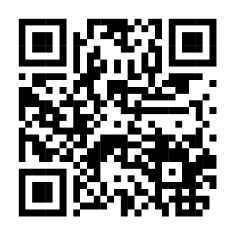
Self-Report Your Credit
This program qualifies for CEBS Compliance credit
Be recognized for the professional education you complete to stay up-to-date
30 credits over two calendar years to be compliant
Credits are self-reported
Scan the QR Code to Self-Report!
Notes:
This is a friendly reminder to self report your CEBS Compliance Credit. You can do this online, under your profile, or by scanning the QR code on this page.

Slide 4


Thank You to our Sponsors
Notes:
We want to say thank you to our sponsors, Marsh McLennan Agency and Baker Tilly!
Our sponsors allow us to present this webinar for free and to host events throughout the year.

Slide 5

Legal Update
ISCEBS DFW Chapter
Kirsten Garcia
September 14, 2023

Slide 6
Health & Welfare Plans: Compliance Check
Broker / consultant compensation disclosures
NQTL comparative analysis / ABA therapy
Gag clause attestation
Verification of EOIs before remitting premiums
Plan Administrator and delegation of authority
  Plan Administrator listed on Form 5500
Monitoring service providers (especially TPAs)
  Kraft Heinz sued Aetna: cross-plan offsets; repriced/reprocessed to pay providers less and keep difference; less rigorous claims adjudication stds for self-funded plans
  DOL sued/fined employer for improper claims adjudication
  Cases involving inadequate denial letters
Oklahoma PBM law preempted by ERISA

Slide 8
Today’s Speaker & Topic
  Buddy Pusateri
  The Landscape of PBMs & Pharmacy

Slide 9
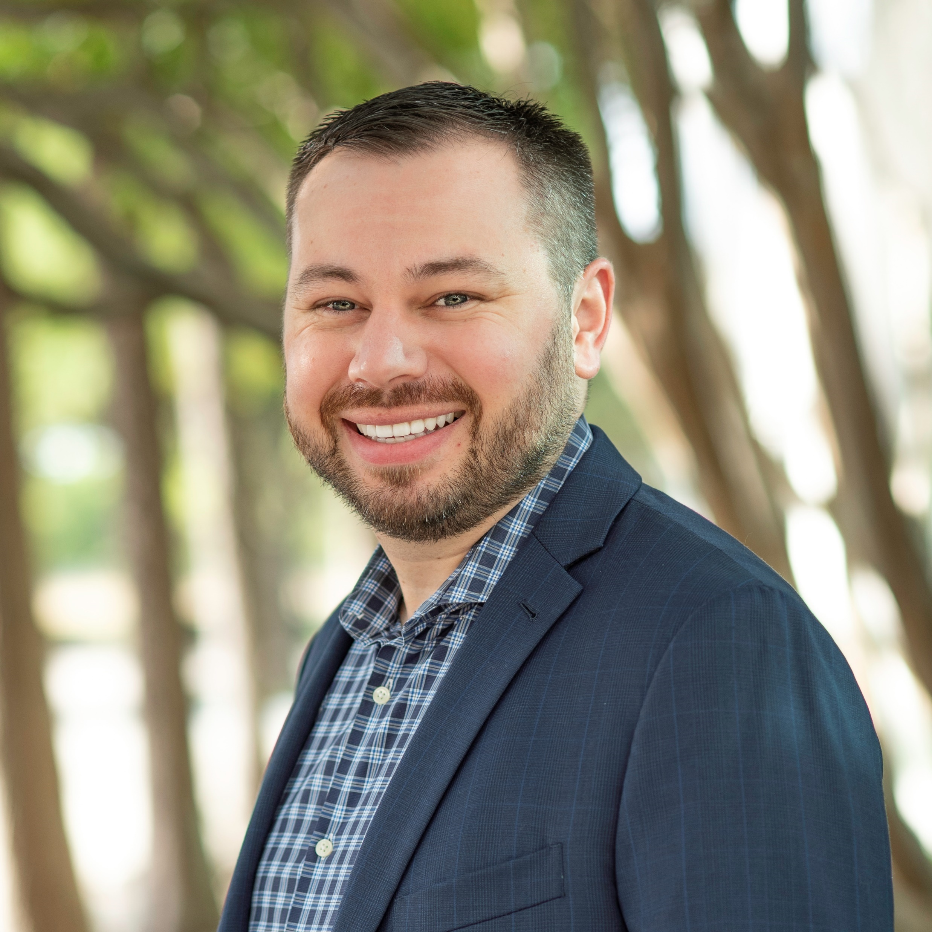
Buddy Pusateri
National Sales Vice President – Optum Rx
Years of experience:
8+ Years in the PBM industry
Education:
University of Wisconsin-Stevens Point
Bachelor of Science in Business Administration and Economics
Background:
Buddy is a National Sales Vice President with Optum Rx. His role was a new addition to the Optum Rx team when he started in early 2023. He leads a team that is dedicated to growing Optum Rx’s business integrated with UHC and UMR by identifying solutions based on the customer and consultant needs.
Prior to joining Optum Rx, Buddy worked for UnitedHealthcare’s Texas market as a Pharmacy Specialist where he was dedicated to retaining and growing their integrated pharmacy book of business. Before joining UHC, Buddy started his PBM career with CVS Health where he was a Strategic Account Executive. In this role, he oversaw client relationships for national sized coalition clients. Buddy was an Account Manager and Account Executive for CVS Health where he learned the operational and strategic aspects of Pharmacy Benefits Management prior to moving into the Strategic Account Executive role. In his free time, he enjoys spending time with his fiancé, Esmira and his son, Maddox. He also enjoys playing guitar and drums, baseball, cooking and the outdoors.

Slide 10

Today’s Agenda
Introduction
Weight Loss Medications
Advancements in Pharmacy Science
Biosimilars
Integrating Pharmacy with Medical
Alternative Funding
Amp-Cap

Slide 11

Key milestones on ‘anti-obesity medications’ class
Diabetes treatment (per FDA)
Weight loss treatment (per FDA)
July:
tirzepatide (active ingredient in Mounjaro) trial published
(note: currently under review and not currently approved for weight loss by the FDA)
Mounjaro FDA approval*
1959 Phentermine: Until recently #1 drug for weight loss
1999 Xenical (Orlistat)
June:
AMA recognizes obesity as a disease state
Victoza FDA approval*
Ozempic FDA approval*
2005
2010
2012
2013
2014
2017
2021
2022
2023
Byetta FDA approval*
(1st GLP1)
July:
Qsymia FDA approval
Bydureon FDA approval*
September:
Contrave FDA approval
December:
Saxenda FDA approval
Trulicity FDA approval*
June: Wegovy FDA approval
February: American Academy of Pediatrics (AAP) publishes guidelines for weight loss medications for children 8+
Expected: Mounjaro FDA approval for weight loss
*Medications approved to treat diabetes. 1. Hampl SE, Hassink SG, Skinner AC, et al. Clinical Practice Guideline for the Evaluation and Treatment of Children and Adolescents With Obesity. Pediatrics. 2023;151(2): e2022060640)
Notes:
Shiara

Slide 12
Known efficacy, side effects and long-term use
Efficacy:
What is the % change from baseline weight for the approved weight loss medications?
Side effects
Saxenda and Wegovy have similar common adverse events that include nausea, diarrhea, constipation and vomiting.
Both include a warning for the risk of rare medullary thyroid tumors (< 1% prevalence in the general population).
Difference from placebo for % change from baseline weight
Contrave (naltrexone/ bupropion) | Qsymia (phentermine/ topiramate) | Saxenda (liraglutide)
-2 to -4 | -4 to -9 | -5
Long term
Studies suggest that medication may need to be continued to maintain weight loss.
One Wegovy trial found that participants regained two-thirds
of their prior weight loss one year after discontinuing medication and lifestyle modifications.²
Inflammation of the pancreas (pancreatitis) noted to occur.
Research on these drugs remains active given early stages.
Tirzepatide (generic Mounjaro)¹ | Wegovy (semaglutide) | Xenical (orlistat)
-12 to -18 | -6 to -12 | -3
Results may vary and dosage is a key factor in treatment.
Diabetes Obes Metab.20221. Pending FDA approval for weight loss indication 2. Citation: Wilding JP, Davies MD, Konakli K et al. Weight regain and cardiometabolic effects after withdrawal of semaglutide: The STEP 1 trial extension. ;24:1553–1564
Notes:
Shiara

Slide 13
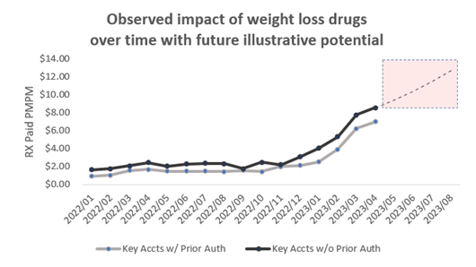
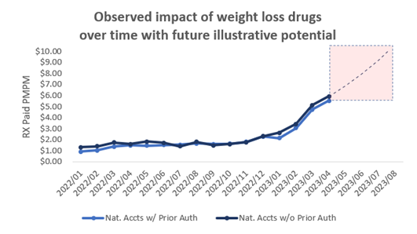
Weight loss drugs and the impact on pharmacy trend
~
40%
UHC ASO adult members meet the eligibility requirements for weight loss drugs laid out by the FDA
<5%
of eligible UHC ASO members are currently taking Wegovy;
this is expected to rise
6%
potential impact on pharmacy trend based on current usage numbers leveling off when clients cover weight loss medications*
>10%
potential impact on pharmacy trend based on usage numbers continuing to rise
* GLP1s are also impacting trend for the treatment of diabetes. 3-4% impact on pharmacy trend.
Notes:
Susan

Slide 14



Advancement of medical science
Impact to payor
Science and technology will accelerate trends seen in specialty medications and require payor innovation to keep clinical advancements affordable
Protection through risk management and financing strategy is necessary
$2M+
Cell & gene therapies
900+
Many gene and cell therapy drugs are one-time, curative therapies with potential to reduce total cost of care, but come with a high-cost
Drug pipeline focus on oncology and biomarker driven gene & cell therapies with a shift from maintenance medication to curative
Investigational new drug applications for gene therapy products in the FDA pipeline¹
Pharmacogenomics has potential to achieve total cost of care savings
<50%
Pharmacogenomics
13%
Response rate to initial antidepressant, costs for managing non-responders are $10k higher per year⁴
Precision medicine and highly personalized care plans
Growth in genetic testing annually to over $10B in 2027²
Opportunities to improve outcomes and decrease health care costs
AI and machine learning
99%
$50
New diagnostic and treatment precision improving opportunities for better outcomes and reduced costs
Of health care executives have or are planning to implement an AI strategy³
Average healthcare savings per prescriber outreach with clinical alerts⁵
1. FDA, FDA Continues Strong Support of Innovation in Development of Gene Therapy Products, 01/2020. 2. U.S. Genetic Testing Market Size, 3. Optum Rx, AI in Health Care Trends. 4. Frontiers in Pharmacology, Pharmacogenomics in Psychiatry: an Update on Clinical Usability, 09/2020. 5. Optum Rx internal data, CES Clinical Program Overview.
Notes:
Content Owner: Zach Morello
Date: May 2022
Science and technology innovation are driving health care treatment to be more efficient in treating people, improving health outcomes and reducing total cost
Gene therapies have the potential to cure rare and fatal diseases, many of which have no cure today.
As important as these therapies are, they present significant actuarial risk and volatility for employers and health plans for two reasons: These therapies are expensive; many cost more than $2 million dollars with some uncertainty on long-term durability. The conditions they treat are extremely rare, making it difficult to predict whether a member will be a candidate for therapy.
The fact that these drugs can lead to a cure rather than simply managing symptoms means they can also lead to a lower total cost of care, if a one-time curative therapy can result in avoiding years of treatments and hospitalizations
Similarly, pharmacogenomics testing comes at a cost, but has the potential to reduce total care costs, by identifying how the body will respond to a medicine before use, preventing costly adverse drug events, side effects, and ineffective drug regimens
Finally, AI and machine learning present a broader opportunity to use multiple data sets, including pharmacy, medical, lab, demographic, social, mental and environmental data, to identify opportunities to conduct targeted interventions to reduce costs

Slide 15



Biosimilars overview
Biosimilars offer highly similar alternatives to innovator biologic agents – increasing market competition and choice, and potentially leading to member and employer savings
No clinically meaningful differences in terms of safety and effectiveness, compared with innovator product
Comprehensive evaluation
of pharmacological, analytical, and clinical studies by the manufacturer and FDA
May differ in clinically inactive components, indications
and product forms
An interchangeable biosimilar needs to meet additional requirements. It must demonstrate that there’s
no additional risk in terms of safety or efficacy by switching between the biosimilar and the innovator. Interchangeable biosimilars may be substituted for the innovator at the pharmacy, depending on state laws.
Notes:
PRODUCT OWNERS: SAVITHA VIVIAN, VIMAL REDDY, BILL DREITLEIN
PRODUCT MARKETING: CONNIE DREWITZ
UPDATED: JANUARY 2022, Additional Notes by Liz April 2022
You’ve heard of these as they have made a big splash a couple of years ago, so I’ll just briefly touch on what they are.
Biosimilars can’t really be viewed as generics to Biologics.
Biosimilar Regulatory Overview
According to the FDA:
A biosimilar is a biological product that is highly similar to and has no clinically meaningful differences from an existing FDA-approved reference product.
An interchangeable biosimilar is defined as a biosimilar that is expected to produce the same clinical result as the reference product in any given patient, and the risk in terms of safety or efficacy of switching or alternating between biological products is no higher than using the reference product alone. Once available, interchangeable biosimilars may be substituted for the reference product without the involvement of the prescriber. Biologics are not universally considered “interchangeable” with the brands and that hinders adoption. Generic drugs are deemed bioequivalent to the branded drug and can be automatically substituted by a pharmacist generally without a call to the prescriber. For Biosimilar only a very small number of biosimilars have the FDA approval as “interchangeable” with the branded biologic products (Semglee is the only available biosimilar with the interchangeability designation as of November 1, 2021; Cyltezo has been approved but will not launch until 2023).
Chemically, they may have different inactive ingredients, even different indications, and formulations than the originator products.
They are FDA approved through a separate BLA application, which requires clinical trials evaluating the pharmacokinetics, efficacy and safety. Biosimilars must show that there are no clinically significant differences in efficacy and safety from the reference product
Cost of biologic manufacturing limits savings potential. The cost of manufacturing complex proteins is considerable and limit the lower bounds of pricing compared to what we would expect with generics in the traditional space. They are typically priced anywhere from only 10% to 30% lower than the originator products.

Slide 16
More blockbuster drugs will confront competition
Inflammatory class projected to lead biosimilar launches throughout this decade¹
Humira®
Inflammatory
conditions
$17.3 B
Enbrel®
Inflammatory
conditions
Simponi® /
Aria®
Inflammatory
conditions
Stelara®
Inflammatory
conditions
Eylea®
Eye disease
Novolog®
Diabetes
$8.5 B
Neulasta® /
OnPro®
febrile
neutropenia
$6.1 B
Tysabri®
MS / Crohn’s
disease
$5.5 B
Actemra®
Inflammatory conditions
$6.0 B
Soliris®
Anemia
$5.1 B
Prolia®
Osteoporosis
$2.4 B
$4.2 B
$2.1 B
$2.7 B
$2.8 B
$2.0 B
2023
2024
2025
2029
¹ 2021 sales based on internal Optum analysis.
Notes:
Humira
Amgen launched AMJEVITA (adalimumab-atto) high cost WAC and low cost WAC on 1/31/2023. Amgen conducting phase 3 trial for high concentration formulation and interchangeability; trial expected to complete in 1/2023; possible launch 1H2024.
Boehringer Ingelheim received FDA approval of CYLTEZO (adalimumab-adbm) on 8/25/2017 and interchangeable status on 10/15/2021; settlement agreement allows launch on 7/1/2023.
Sandoz received FDA approval of HYRIMOZ (adalimumab-adaz) on 10/31/2018; settlement agreement allows launch on 7/1/2023.
Samsung Bioepis/Organon received FDA approval of HADLIMA (adalimumab-bwwd) on 7/23/2019; a settlement agreement allows launch after 6/30/2023. Interchangeability study ongoing with results expected in 2024-2025.
Pfizer received FDA approval of ABRILADA (adalimumab-afzb) on 11/18/2019; a settlement agreement allows launch of citrate-free on 7/1/2023. Successful interchangeability study results for ABRILADA reported in 9/2021; BLA for interchangeability has been accepted; PDUFA is 2Q2023.
Viatris received FDA approval of HULIO (adalimumab-fkjp) on 7/6/2020; settlement agreement allows launch in 7/31/2023.
Coherus received FDA approval of YUSIMRY (adalimumab-aqvh) on 12/20/2021; settlement agreement allows launch on 7/1/2023; expected to launch in 3Q 2023. Coherus developing a high concentration formulation.
Teva/Alvotech filed a BLA for biosimilar and interchangeable HUMIRA (AVT-02 - 100 mg/mL); PDUFA is 6/28/2023 for biosimilarity and interchangeability. Settlement agreement allows launch on 7/1/2023 for this 100 mg/mL strength.
Celltrion filed a BLA for biosimilar HUMIRA (Yuflyma - 100 mg/mL); est. PDUFA is 2Q2023; settlement agreement allows launch on 7/1/2023. Celltrion also conducting interchangeability studies with results expected in 2023-2024.
Samsung Bioepis/Organon received FDA approval of HADLIMA 100 mg/mL on 8/17/2022; settlement agreement allows launch on 7/1/2023. Organon also conducting interchangeability studies.
Fresenius Kabi received FDA approval of IDACIO (adalimumab-aacf) on 12/14/2022; settlement agreement allows launch beginning in 7/2023.
Sandoz received FDA approval of HYRIMOZ HCF (adalimumab-adaz) on 3/20/2023; settlement agreement allows launch on 7/1/2023.
Momenta has signed a settlement agreement allowing launch of its biosimilar HUMIRA (M923) on 11/20/2023 (J&J bought Momenta and is no longer developing M923).
Tysabri
Sandoz/Polpharma's BLA for biosimilar TYSABRI (PB-006) was accepted by the FDA in July 2022; est. approval is May 2023; plans to launch in late 2023-2024.
Actemra
Fresenius BLA for biosimilar ACTEMRA IV and SC (MSB11456) accepted by FDA in August 2022; est. PDUFA is 2Q2023. Launch of IV could occur after approval; launch of SC could be delayed until 2026-2027.
Biogen/Bio-Thera Solutions BLA for biosimilar ACTEMRA IV (BIIB800) accepted by FDA in December 2022; est. PDUFA is 12/2023.
Stelara
Amgen filed biosimilar STELARA (ABP 654); estimated PDUFA is 2H 2023; likely to launch after patent expiration in September 2023.
Alvotech/Teva filed biosimilar STELARA (AVT-04) in November 2022; est. PDUFA is 2H2023.
Dong A ST/Intas/Accord released phase 3 results for biosimilar Stelara (DMB-3115), citing therapeutic equivalence and safety with Stelara; plans to submit a BLA in 1H2023.
Celltrion, Biocon, Formycon/Aristo/Bioeq, Samsung Bioepis, and Bio-Thera/Hikma are conducting phase 3 trials for subcutaneous formulation.
Neulasta Onpro
Coherus submitted a BLA for Udenyca (pegfilgrastim-cbqv) on-body injector (OBI) in January 2023; est. PDUFA is October 2023.
Fresenius is developing a biosimilar "On Body Device" presentation of NEULASTA ONPRO (MSB11455 OBI) that it expects to launch in 2023.
In January 2022, Lupin disclosed that it is "also working on an on-body product" (Lupifil P OBI) that it "expect[s] to file in this calendar year.“
Novolog/Flexpen
Novo Nordisk launched an authorized brand alternative of NOVOLOG on January 2, 2020 at a 50% discount.
Viatris/Biocon submitted a BLA with interchangeability for biosimilar NOVOLOG (MYL-1601D); CRL issued on 10/21/2022; unknown resubmission.
Amphastar plans to file biosimilar and interchangeable NOVOLOG (AMP-004) in 2023.
Simponi/Aria
Bio-Thera plans to file biosimilar SIMPONI ARIA and SIMPONI IV (BAT2506) in 2023.
Alvotech plans to file for biosimilar SIMPONI ARIA and IV (AVT05) in 2023; also planning for interchangeability.
Eylea
Wet Age-Related Macular Degeneration; Diabetic Macular Edema; Macular Edema Following Retinal Vein Occlusion; Diabetic Retinopathy in Patients with Diabetic Macular Edema
Viatris/Biocon filed a BLA for biosimilar EYLEA (M-710) in October 2021; estimated PDUFA is 2Q2023; plans to launch in 2024.
Coherus plans to submit biosimilar EYLEA in 2H2023; launch is expected in 2025.
Novartis plans to submit biosimilar EYLEA for neovascular age-related macular degeneration in 2024.
Amgen's phase 3 studies of ABP 938 (biosimilar EYLEA) are progressing.
Samsung Bioepis/Biogen, Alvotech (AVT06) and Celltrion are conducting phase 3 trials.
Prolia/Xgeva
Sandoz filed a BLA for biosimilar PROLIA and XGEVA that was accepted by the FDA in February 2023; est. PDUFA is 12/6/2023; launch likely won't occur until after patent expiration in 2/2025.
Alvotech plans to file biosimilar PROLIA (AVT03) for regulatory approval in 2023.
Celltrion is planning for commercialization of biosimilar PROLIA (CT-P41) in 2025.
Teva, Biocon and Fresenius are conducting phase 3 trials..
Soliris
Per a settlement agreement, Amgen could market its biosimilar SOLIRIS (ABP 959) beginning 3/1/2025. The DAHLIA study (phase 3, crossover between ABP 959 and SOLIRIS) in 42 adults with PHN demonstrated no clinically meaningful differences between the two products.
Samsung Bioepis announced positive phase 3 results with SB12 (biosimilar SOLIRIS).
Cimzia
Biogen and Xbrane Biopharma developing biosimilar CIMZIA (XCIMZANE); clinical trials are expected to start in 2023.
Enbrel
Sandoz received FDA approval of ERELZI (etanercept-szzs) on August 30, 2016. Launch delayed until 2029. A study switching from Enbrel to Erelzi did not impact efficacy and safety in patients with rheumatoid arthritis at 48 weeks.
Samsung Bioepis received FDA approval of ETICOVO (etanercept-ykro) on 4/26/2019; launch likely will be close to Erelzi's launch.

Slide 17

Several Humira biosimilars launch this year
Amjevita (adalimumab-atto) – Amgen
FDA approved
Launch date: 1/31/23
2/1/23 – 1 biosimilar
7/1/23 – 7 biosimilars
Cyltezo (adalimumab-adbm)**
Boehringer Ingelheim
FDA approved
Launch date: 7/1/23
Hulio (adalimumab-fkjp) – Viatris²
FDA approved
Launch date: 7/1/2023
Hyrimoz (adalimumab-adaz) - Sandoz
FDA approved
Launch date: 7/1/23
Idacio – Fresenius Kabi
FDA approved
Launch date: 7/1/23
Key dates that impact PDL decisions
Yusimry (adalimumab-aqvh) - Coherus
FDA approved
Launch date: 7/1/23
Hadlima (adalimumab-bwwd)
Samsung Bioepis / Organon¹
FDA approved
Launch date: 7/1/23
Yuflyma* – Celltrion
FDA approved
Launch date: 7/1/23
Future date
Abrilada (adalimumab-afzb) - Pfizer***
FDA approved
Launch date: Undetermined
AVT-02*** – Teva/Alvotech
FDA issued second CRL 4/14/23
Launch date: Undetermined
**Denotes interchangeability status. ***Have filed for interchangeability.
1 - Organon is a spinoff from Merck, partnering with Samsung Bioepis. 2 - Viatris is a combination of Mylan, and the former Pfizer Upjohn business

Slide 18
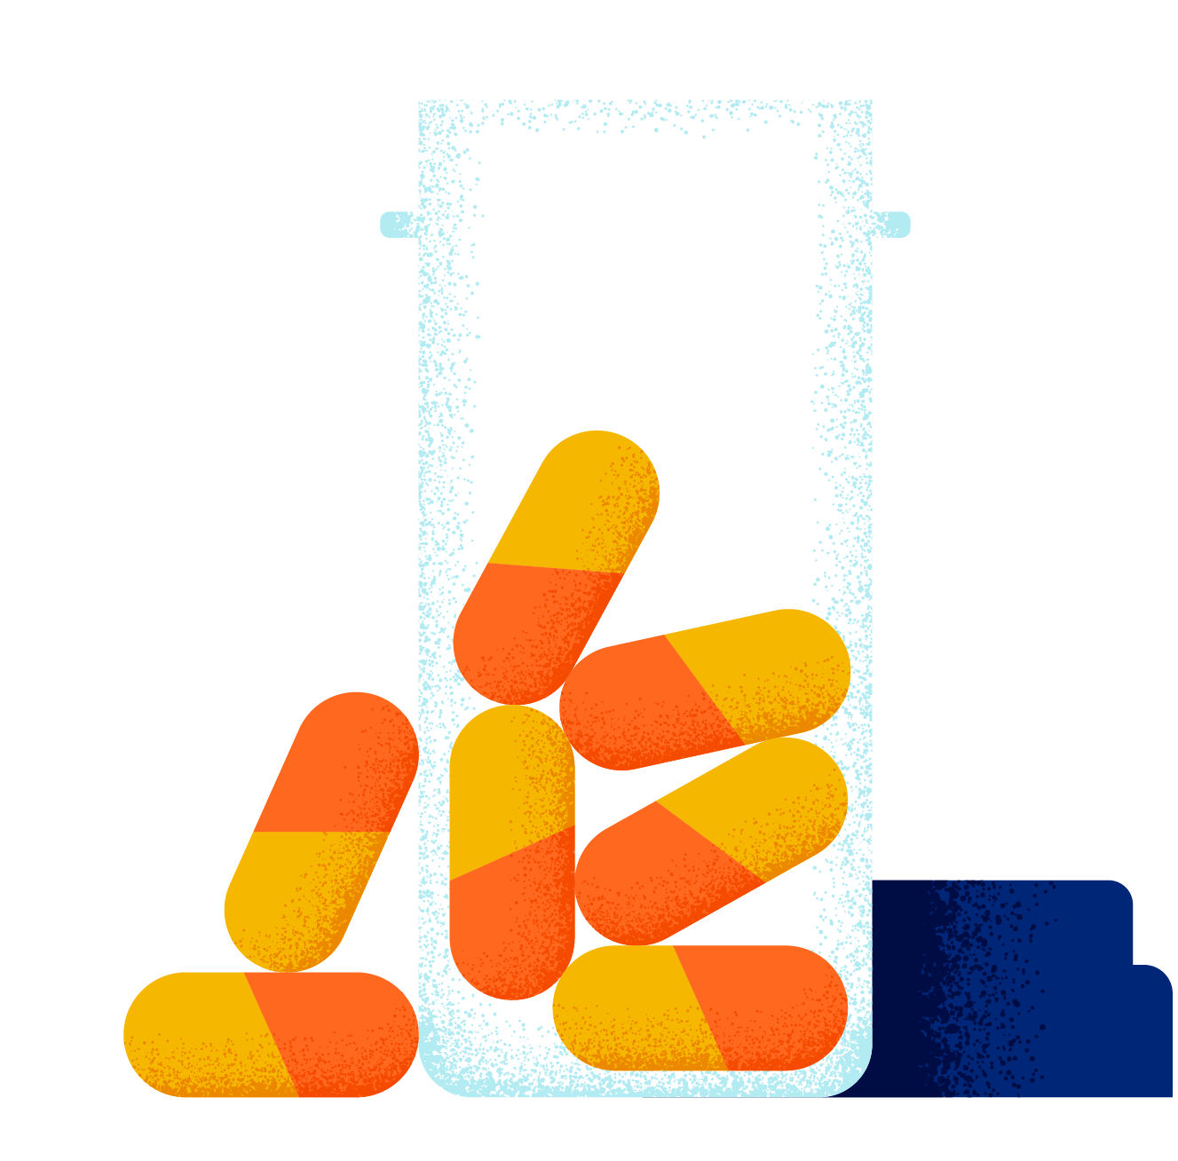
Value of pharmacy integration
Up to
$29
Core services
Enhanced services
Medical benefit management with advocacy model and payment integrity
Pharmacy integration, enhanced advocacy model and personal health support offering
PMPM in medical
cost savings
with an integrated approach¹
¹ Internal study based on 2020 analysis of 91-100 UnitedHealthcare National Accounts data. This is not a guarantee. Actual guaranteed savings will vary based on benefit, program design and population size.
Notes:
Tim
Core services: Starting point
Enhanced services: Driven by integrated medical, pharmacy, and enhanced advocacy and condition management programs.
When you combine medical with pharmacy data, you have the insights you need to aggressively drive to the lowest net cost. This is what makes integration so different from standalone pharmacy benefit managers. When benefits were combined, we saw an increase of 11–18% in medication adherence for top chronic conditions.¹ Integrated benefits also allowed 43%–55% of hospital or outpatient facility utilization to be shifted to optimal site of care locations.² Our studies showed that clients that have integrated medical, pharmacy, and enhanced advocacy and condition management programs had $28 PMPM lower medical costs versus those that didn’t have an integrated pharmacy approach. [Source on slide]
_________
¹ Based on 2017 claims data for 3.3M members measuring the medical savings impact of synchronized medical and pharmacy benefits and capabilities.
² Specialty Site of Care program, based on UnitedHealthcare Commercial Fully Insured data 2018/2019.

Slide 19


Optum Rx Price Edge
Delivering value through the pharmacy benefit
A simple way to save on non-specialty generic drugs, covered or not.
Our claim system scans discount card market pricing and compares it to the benefit – giving members a competitive price.
Adjudicates at market competitive rate
Improves member experience
5-15%
Retains medical history for drug and clinical programs
Reinforces value of pharmacy benefit and plan sponsor
of the time, our solution beats traditional generic on-benefit pricing¹
Demonstrates member savings through client reporting
Offers added value at no program cost to client or member
1. 2020 Optum Rx commercial client analysis.
Notes:
PRODUCT OWNER: JOHN BROCKBERG/PATTY LUBEK
MARKETING OWNER: MALIA ROETMAN
UPDATED JUNE 2022
Our Solution: Optum Rx Price Edge does all the comparisons for your members — so they know they are getting a competitive price for all their drugs, covered or not. They’ll also get peace of mind knowing that our clinical oversight means they’re taking the right medication for them.
To ensure members are receiving a competitive rate on generic drugs, our claim system continually scans discount card market pricing and compares it to the benefit in real time – giving members a competitive price. In addition to the consumer pricing advantage, this reinforces the value of the employer-sponsored benefit plan and helps retain members in the benefit plan who may be less inclined to price shop.
For covered drugs this looks like:
We have developed a new “cash informed” Price List based on Optum Perks (our owned discount card) and other publicly available cash market price points.
You can think of this price list as a new MAC list
We have enhanced our claims adjudication platform, RxClaim, to look at this cash informed price list, and if the available cash informed price is lower than the member’s on-benefit cost-share, it triggers and adjudicates as an on-benefit claim, applying to accumulators and out of pocket max.
For non-covered drugs this looks like:
When a non-covered claim is submitted, it rejects in our system (with a R70/ “drug not covered” reject code)
Messaging is push to the point of sale and a discount price is offered to the member
The member pays 100% out of pocket for the drug, and because this is still a not covered drug, the claim does not apply to accumulators and out of pocket max; it does, however, remain in our claims history and clinical programs and safety edits wrap around it.
This element of the program can save members up to 85% off of retail.
Real-time drug benefit insights help ensure members receive competitive generic drug pricing:
Adjudicates at market competitive rate – the cash informed Price List is based on Optum Perks (our owned discount card) and other publicly available cash market price points. We don’t promise to have the lowest cost every single time, or match GoodRx or other price points, but we think we have an everyday low price. We update the list quarterly. Volatility in prices in the cash market – up and down – is a pain point for members that we wanted to address.
Retains medical history for drug and clinical programs – for both covered and non-covered drugs, our clinical programs (i.e., drug utilization review) and safety edits are in place, providing a 360 degree view of the member. Claims are in claims history files (versus losing visibility to the claim if they were to go to the cash market)
Demonstrates member savings through client reporting
Improves member experience – for covered drugs, this manifests as better on-benefit pricing for the member. They don’t have to take any action to get the benefit of this program.
Reinforces value of pharmacy benefit
Offers added value at no cost to client or member
Research shows:
Up to 15% of the time, Optum Rx Price Edge beats discount card pricing¹
Sources: 1. 2020 Optum Rx commercial client analysis.
Additional Talking Points:
The product delivers competitive pricing for generic medications through the following:
Low-cost pricing: Provides members a competitive price with their drug benefit
Seamless member experience: Operates with the existing benefit plan; no opt-in or separate card required
Performance monitoring: Tracks when the product is utilized, member cost savings, and drugs most often adjusted
Consistent experience: Integrates all digital touch points where member is interacting with their plan, whether they are at the pharmacy counter, on optumrx.com, the mobile app or home delivery

Slide 20
Specialty illustration: Alternative funding vs Integration
Specialty Rx claims are excluded from plan coverage and become full responsibility of the member
(with support from third party administrator to secure alternative funding)
Considerations
Administration fees
Prescription Drug List composition
Loss of savings from clinical programs
Loss of discounts
Loss of rebates
Impact to stop-loss coverage
Shared savings fees
Fragmented employee experience
Limited funding assistance availability
Impact to medical spend
Manufacturer lawsuits
Personal financial disclosure
requirements
~30%** of $800,000
-------------------
$240,000
Actual amount
plan paid
$440,000
Carve-out solution
$485,184
Integrated solution
Shared savings
20%
non-secured funding*
$240,000
$1,000,000
$800,000
$200,000*
$200,000
$487,181
Submitted claims
Alternative funding paid claims
Plan paid
claims
Alternative funding solution (with third party)
Current plan paid net rebates
(With UHC)
* Illustration assumes 20% of claims can’t be secured by alternative funding vendor and must be paid by the plan
** Illustration assumes ~30% of savings taken as compensation by alternative funding vendor
1. Savings example based on UnitedHealthcare analysis of commercial ASO data for 2021. Information provided for illustrative purposes only. Actual savings will vary and depend upon various factors.
Notes:
If you consider carving out specialty medications, you will likely receive an analysis with a projected savings amount. The savings amount is usually significant and can reach higher than 80% or greater of your specialty spend. This savings amount is likely overstated because the starting point for the analysis and many other key factors are missed.
When we consider the overall impact of carving out specialty medications it is vital to consider all the elements discussed in the previous waterfall slide. Identifying the correct starting point for the analysis is vital to get an accurate projection. Identifying and beginning with an accurate submitted claim number vs paid claims will provide a more realistic and accurate savings amount.
With all factors taken into consideration the alternative funding solution may provide some savings. However, the amount of total savings may not be significant enough to offset the member’s experience and well being.
Other items to consider are:
Administration fees- You will likely see an increase in administration of the plan with medical only coverage. Higher shared savings fees for medications utilized that would not have been covered under the current plan. This further reduces savings expected from the program and remains hidden.
PDL composition- Overall spend increase moving to a PDL with less management features. Higher claims with the new PBM.
Clinical Programs- Moving to programs not as defined and lightly managed will increase claims. Not having clinical management and simply directing to Patient Assistance drives spend higher and shared savings amount higher. Meds that would have been reviewed and redirected or stopped not meeting criteria flow thru to patient assistance.
Loss of Discounts- Savings analysis completed assuming our discounts would be in place going forward. New PBM discounts not as aggressive. What is the starting point or cost of the med not run through the plan? Is the patient assistance amount greater than the net cost of the med(discount and rebate)?
Loss of rebate- This is not only an immediate impact but a future impact as well. This should continue to be considered when trying to truly understand what were the savings.
Impact to Stop Loss- Cannot continue with UHC stop loss. There are fees charged to manage outside stop loss management. Are you paying an amount greater than your stop loss limit(member hits stop loss and you continue to pay shared savings fees above that amount).
Shared Savings fees- fees are 20% to 30% of savings. These are paid on medications that may have been excluded or stopped with current clinical management.
Employee experience- delay of care, fragmented care, loss of insight by Optum disease management, Personal financial disclosure requirements.
Limited funding availability- not everyone qualifies. Patient assistance funding runs out.
Medical spend impact- Increase to medical spend due to lower engagement, lower health activation, $28PMPM increase in medical claims not taken into the financial analysis.
Manufacturer Lawsuits
Possible ERISA and Tax issues.

Slide 21

Average Manufacturer Price Medicaid Rebate Cap (AMP-Cap)
Removal and Manufacturer Changes to Drug Pricing
The federal government has been exploring way to lowers Americans’ drug costs – the AMP Cap removal may lead drug manufacturers to reduce their drug prices and limit future increases.
A variety of factors including evolving marketplace and legislative landscapes and consumer pressure to make insulin more affordable may have contributed to drug manufacturer announcements of insulin product price reductions.
The change to Medicaid rebates, which no longer limits the rebates that a manufacturer has to pay when they have experienced a price increase that exceeds the rate of inflation, has also played a part in drug manufacturer decisions.
Due to the passing of the American Rescue Plan, the cap which limits Medicaid rebates to 100% of the Average Manufacturer Price (AMP) will be removed effective January 1, 2024. With this change, manufacturers may face monetary penalties in the form of increased rebates to be paid to Medicaid if they do not lower their prices
Linked below are several articles
covering the pending removal of AMP-Cap
Why does insulin cost so much? Big Pharma isn’t the only player driving prices
By cutting insulin prices, Eli Lilly avoids paying big Medicaid rebates
Kaiser Health News Lilly-PBM Article
Eli Lilly’s insulin cap is putting pressure on PBMs
Lilly’s perfect timing for insulin cuts
Eli Lilly places price cap of $35 on out-of-pocket insulin cost
Sanofi Is Now the Third Insulin Producer to Slash Prices
Manufacturers could face higher penalties for certain drugs, including insulin, beginning in January, 2024, when the American Rescue Plan goes into effect. These penalties may be potentially mitigated by reducing the price of impacted drugs before the American Rescue Plan goes into effect.
Notes:
Marketing Owner: Carey Kane

Slide 22


Thank you!
Q&A
Notes:
Tom

Slide 23
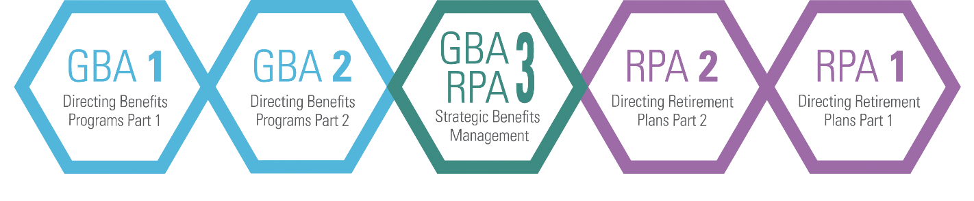
Refer a Friend to CEBS!
Let a colleague know about the CEBS program and the opportunities it presents! CEBS also offers a new Success Package for each course that is a 20% discount when you purchase the study guide, textbook, online study group and exam.
Notes:
Janie, thank you so much for this information. I believe this is the first time we’ve had a speaker on compensation and pay – we’d love your feedback and recommendations on speakers/topics for 2024.
Many of us know the value of the CEBS designation and we want to encourage you to tell your colleagues and friends in the industry.
The CEBS program is currently 5 courses and has a virtual exam, which is a real perk for those who don’t live close to a testing center or have testing anxiety.
Please spread the word about the value of the CEBS designation and organization.

Slide 24

42nd Annual Symposium
August 20-23, 2023
The Westin Seattle
Seattle, Washington
Notes:
Symposium report – things learned – contact Rachel and Barbara for details on sessions

Slide 25
Don’t Forget to Self-Report Your Credit
Today’s session qualifies for 1 Credits
www.ifebp.org/myprofile
and select the orange box
Manage Your CEBS Compliance Credits
Scan the QR Code to Self-Report!
Notes:
One more reminder to self report your attendance at today’s session.
And remember that if there are other events you attend throughout the month, you can report those as well.

Slide 26

October Happy Hour Networking Event
Thursday, 10/26/2023
Swizzle Dallas (www.swizzledallas.com)
1802 Greenville Avenue
Notes:
Symposium report – things learned – contact Rachel and Barbara for details on sessions

Slide 27
Join Us for Our Next Events!
October – in person networking event – Swizzle
November – Retirement Plans with Jim Griffin – Webinar
December – members holiday lunch – Maggiano’s
Visit our website:
www.dfwiscebs.org

